Slide 1
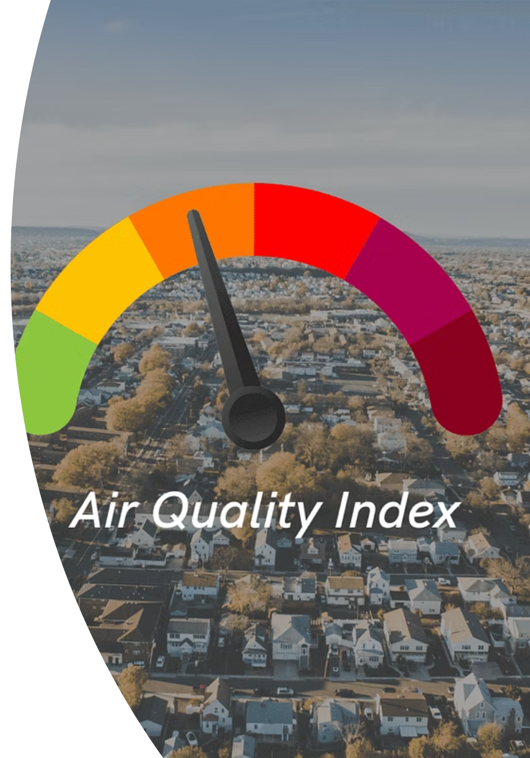
Forecasting Air Quality Using Historical Pollution Data
A Time Series Forecasting System for Healthier Urban Decision-Making
Presented By :
Suhas Alagi

Slide 2

Project Statement:Air Quality Prediction
Air pollution is a critical and growing concern in urban environments, directly impacting human health and environmental quality.
Accurate forecasting of air quality is essential to help authorities take preventive measures, issue timely warnings, and inform the public.
This project aims to build a robust time series forecasting system that predicts the Air Quality Index (AQI) and specific pollutant levels using historical data, empowering agencies and the public with timely insights.

Slide 3
Key Outcomes and Objectives
Accurate Forecasting Model
Visual Dashboard & Alerts
Predict AQI and key pollutants (PM2.5, PM10, NO2, etc.) using advanced time series models.
Provide a dashboard showing historical trends, future predictions, and automated warnings when AQI crosses safety thresholds.
Trend Analysis & Insights
Admin Functionality
Analyze pollutant contributions and seasonal trends to inform long-term environmental strategies.
Enable administrators to upload new datasets and retrain models for continuous forecasting updates.

Slide 4
System Architecture: From Data to Dashboard
The system follows a standard data science pipeline, integrating data ingestion, model training, and a user-facing application.
Data Sources
Modeling
CPCB, OpenAQ, Kaggle datasets.
ARIMA, Prophet, LSTM, XGBoost.
Deployment
Streamlit Web Interface.

Slide 5





Core Modules: Implementation Plan
Data Collection & Preprocessing
Load, clean, resample, and engineer features (season, temperature) from historical datasets.
Forecasting Model
Train and compare models (ARIMA, LSTM) using MAE/RMSE. Save the best model for inference.
Alerting & Trend Analysis
Calculate AQI categories, highlight high-risk days, and visualize long-term seasonal trends.
Web Interface & Admin Panel
Develop a Streamlit dashboard for visualization, user selection, and model retraining controls.

Slide 6
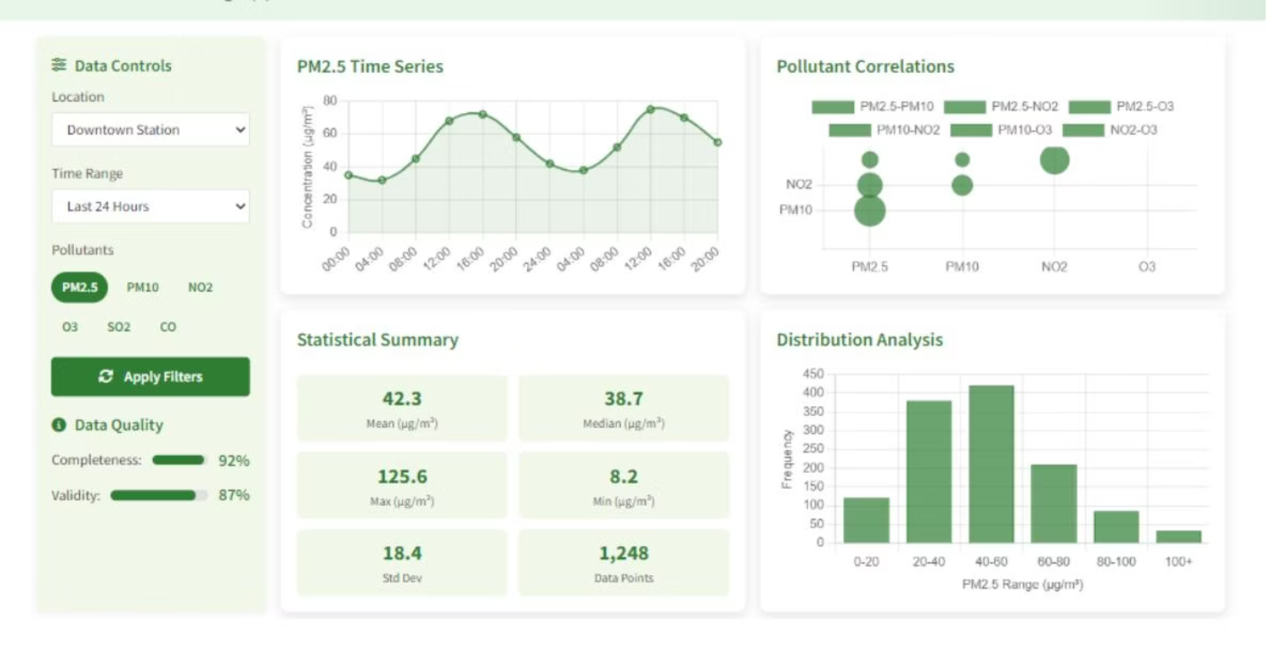
Data Collection and Preprocessing
Data Sources & Cleaning
Load historical air quality datasets from CPCB, OpenAQ, or Kaggle.
Handle missing timestamps and resample time series (hourly/daily).
Normalize pollutant values and manage outliers for model stability.
Feature Engineering
Extract temporal features: day of week, month, season.
Incorporate external features like temperature or wind speed, if available.

Slide 7


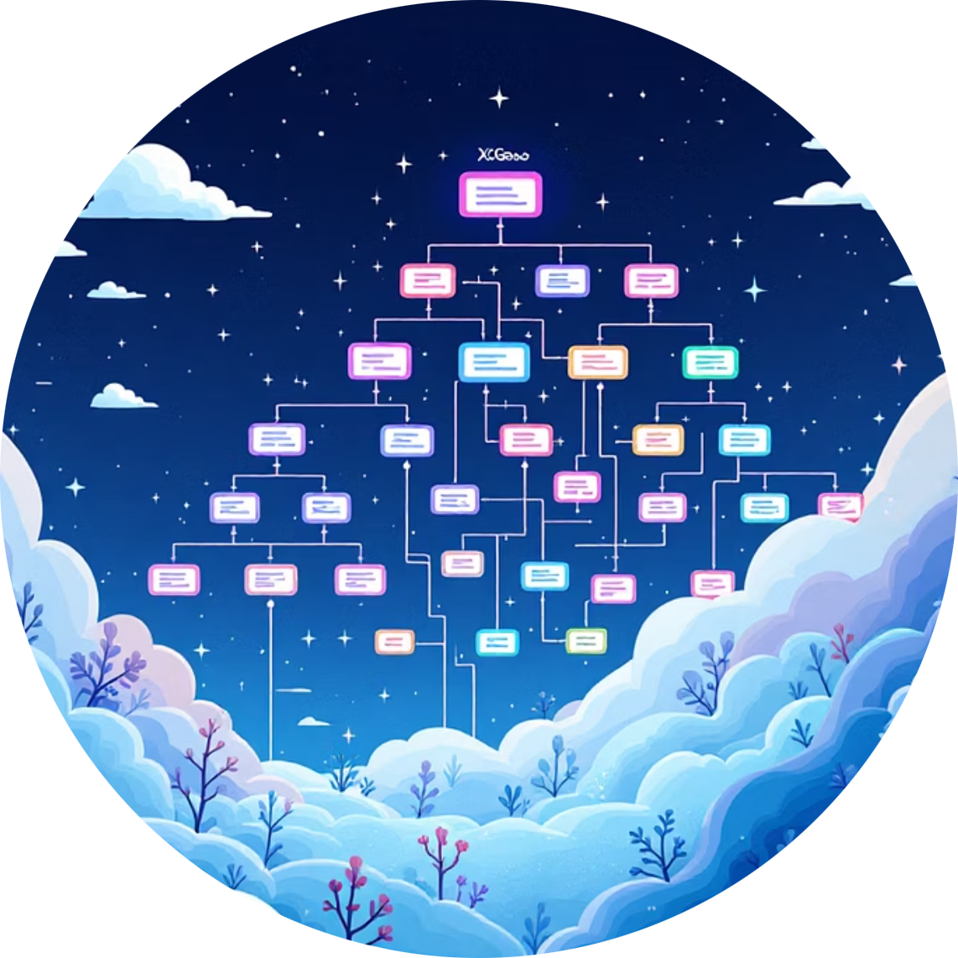
Model Development and Evaluation
We will test multiple time series models to find the most accurate predictor for regional air quality.
Classical Models (ARIMA/Prophet)
Deep Learning (LSTM)
Ensemble Methods (XGBoost)
Baseline models for time series forecasting, focusing on statistical patterns and seasonality.
Advanced models for capturing complex non-linear dependencies and long-term patterns in the data.
Utilizing lag features and external variables for robust, high-performance predictions.

Slide 8

Web Application Implementation (Streamlit)
Interactive User Interface
Allow users to select city/station and forecast date range.
Display line plots of predicted pollutant levels.
Feature an AQI gauge meter for immediate status visualization.
Show alert banners for predicted high-risk days.
Admin Panel
Secure interface for uploading new CSV datasets.
Functionality to trigger model retraining with updated data.

Slide 9
Project Workflow and Milestones
The project is structured into four two-week milestones, ensuring systematic development and evaluation.
Weeks 1–2: Data & EDA
Weeks 5–6: Alert Logic & Trends
Download, preprocess data, and conduct Exploratory Data Analysis (EDA).
Implement AQI calculation, alerting mechanisms, and generate visual trend reports.
1
2
3
4
Weeks 3–4: Model Training
Weeks 7–8: Web Dashboard
Train and evaluate ARIMA/Prophet/LSTM models. Select and save the best model.
Develop and deploy the Streamlit dashboard with full visualization and admin features.

Slide 10


Conclusion and Future Scope
Key Achievements
Future Enhancements
Developed a robust, evaluated time series forecasting model for AQI and pollutants.
Integrate real-time meteorological data (wind, humidity) for improved accuracy.
Created an interactive dashboard for public and administrative use.
Expand to hyper-local forecasting using spatial data and GIS integration.
Implemented a functional alerting system for high-risk pollution days.
Develop a mobile application for on-the-go public alerts and information.

